Slide 1
Chemistry:
What are solids, gasses and liquids made of?
How do they combine and change?
How do we use chemistry in our everyday lives?
Notes:
Give welcoming comments about what the subject is defined as.
Ask for student input about what they associate with the subject. For example:
What comes to mind when you think about Chemistry?
What sorts of questions do you think we’ll be answering in this class?
What ideas do you already have about Chemistry?
Transition to exploring the specific topics that will be covered in the course for the next slide

Slide 2
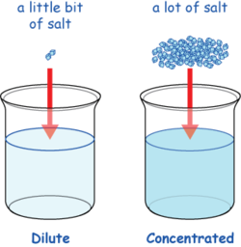

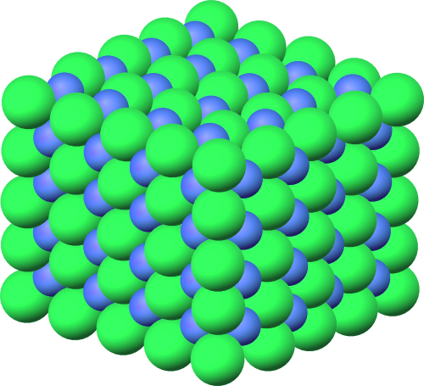
Atomic
Structure
Scale and
Quantity
Reactions
Topics in Chemistry
Phases of
Matter
Acids and
Bases
Bonding and
Structure
Heat and
Energy
Notes:
Each topic will appear one at a time- with each title, ask students to share what they know or what they think is meant by the title. For example:
When atomic structure appears, ask students “What sort of things do you think we will discuss when we study atomic structure?”
If students need help brainstorming, showing the picture may help them
If students are struggling to share ideas, give an example or two for one topic and try to have them share what they know on another (consider in advance which topics you think will be easiest for them, and which will be hardest)
After student input, share the picture and give a short summary description, pulling in their ideas when possible.
For example, “Sounds like you have already heard a lot about atoms! When we study atomic structure we’ll be building on your knowledge of protons, neutrons, and electrons. We will learn about how we came to know about the parts of the atom and also analyze how those parts effect the behavior and patterns of atoms.
Some topics have great opportunities to give a demonstration or example related to the topic.
For example, show a sample reaction (e.g. baking soda and vinegar) and talk about how they will be studying what makes reactions work, how they can be predicted, and how we can represent them.

Slide 3
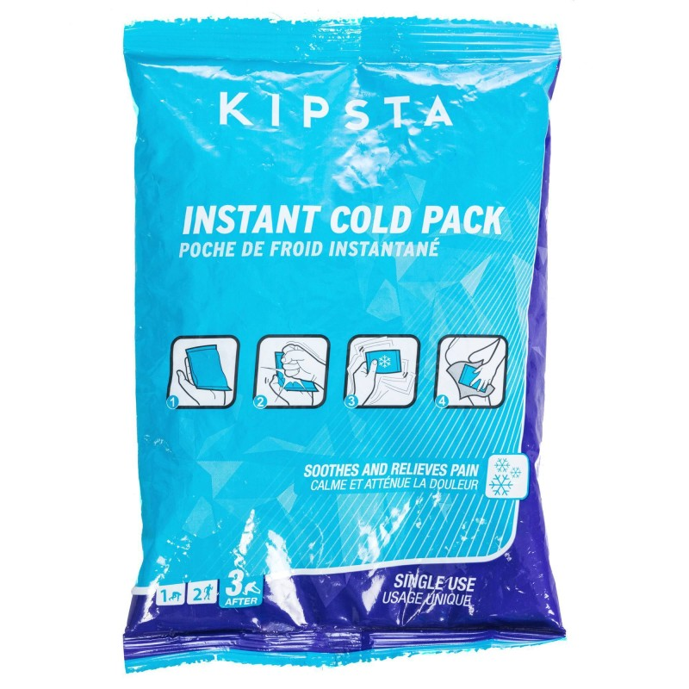
Instant Ice Packs

Slide 4
Rechargeable Lithium-ion batteries

Slide 5
Glycerin as an ingredient

Slide 6
Which chemistry topic(s) do you think would help you explain these phenomena, and why?
Choose one phenomenon to discuss with your partner.

Slide 7
Scale and
Quantity
Atomic
Structure
Reactions
Topics in Chemistry
Phases of
Matter
Acids and
Bases
Bonding and
Structure
Heat and
Energy
Notes:
Each topic will appear one at a time- with each title, ask students to share what they know or what they think is meant by the title. For example:
When atomic structure appears, ask students “What sort of things do you think we will discuss when we study atomic structure?”
If students need help brainstorming, showing the picture may help them
If students are struggling to share ideas, give an example or two for one topic and try to have them share what they know on another (consider in advance which topics you think will be easiest for them, and which will be hardest)
After student input, share the picture and give a short summary description, pulling in their ideas when possible.
For example, “Sounds like you have already heard a lot about atoms! When we study atomic structure we’ll be building on your knowledge of protons, neutrons, and electrons. We will learn about how we came to know about the parts of the atom and also analyze how those parts effect the behavior and patterns of atoms.
Some topics have great opportunities to give a demonstration or example related to the topic.
For example, show a sample reaction (e.g. baking soda and vinegar) and talk about how they will be studying what makes reactions work, how they can be predicted, and how we can represent them.

Slide 8
Experts in which topic area might be helpful when…
…designing safer football helmets?
Notes:
Questions to help students think creatively about the needs to know the other topics:
What would a designer want to know about the materials they are using?
What input could someone who knows about (phases of matter, energy, reactions, bonding and structure) provide?

Slide 9
Experts in which topic area might be helpful when…
…creating a more efficient and environmentally friendly car?

Slide 10
Experts in which topic area might be helpful when…
…clearing the air of smoke from wildfires

Slide 11
In ten words or less...
What experiences, problems, or questions have you had that could connect to the areas drawn on the white board?
Place your sticky note on the flip chart near the topic you think it would most relate to.

